Slide 1
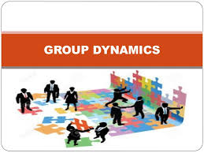

PRINCIPLES OF MANAGEMENT & PROFESSIONAL ETHICS
SUBJECT CODE - SBA1101
UNIT - IV

Slide 2
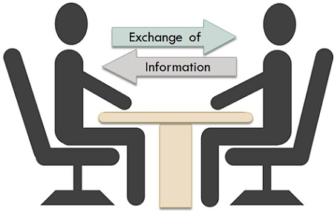
COMMUNICATION

Slide 3
COMMUNICATION
Derived from the Latin word ‘communis’ which means common
Process of sharing facts ideas and opinions in common
Communication is the process of passing information and understanding from one person to another. – Hainmann
Communication is a way that one orgn member shares meaning and understanding with another. – Koontz and O’Donnell
Communication is an exchange of facts, ideas, opinions or emotions by two or more persons – Newman and Summer
Communication is defined as a process of meaningful interaction among human beings
Process by which meanings are perceived and understandings are reached among human beings. – Dalton E. Mcfarland.

Slide 4
NATURE OF COMMUNICATION
Two way process:
Communication take place only when there are at least two persons, one person has to convey a message and another has to receive it
Example: in classroom a teacher com to students
Knowledge & Language:
For successful communication both the parties that is sender and the receiver should know the language
Example: If the receiver cannot understand English then the sender of message conveys his ideas in English will be meaningless
Meeting of minds necessary:
Receiver must understand the message in the way the sender wants him to understand
For example: if weekly target announced by a supervisor is misunderstood by a worker as monthly target here there is problem (lack of attention, faulty pronunciation)

Slide 5
NATURE OF COMMUNICATION
Communication may be made through gestures:
Communication is not only by oral & written it is also by gestures
Example: Nodding of heads, rolling of eyes etc
Communication is all-pervasive:
Communication is omni present. It is found in all levels mgmt
Example: Top mgmt com to middle mgmt, middle com to supervisors etc
Communication is a continuous process:
Sharing or exchanging information is an ongoing activity, as long as there is work there is communication
Example: personal, official or unofficial
Communication may be formal or informal:
Formal com follow the hierarchy,informal does not follow
Example: If a worker wants to communicate to production mgr then he can inform to foreman and through foreman he can communicate

Slide 6
FUNCTIONS OF COMMUNICATION
Helps in Planning:
Helps to prepare better plans for the org. the views, suggestions of employees, clients, suppliers etc are received and the plans are prepared.
Vital for decision making:
Proper communication is necessary for right decision. For Example: To buy the raw material the production mgr has to consult with marketing manager for the demand and with stores mgr about the stock.
Facilitate delegation:
Proper com is needed to delegate the authority to subordinate.
Facilitates effective leadership:
Manager will be able to guide to this subordinates through communication.
Helps to motivate:
Encourage, induce com necessary.
Helps in coordination
Helps to save time and effort:
If manager wants to announce a decision to all employees he can send a circular.
Helps for public relations:
Includes customer, creditors, shareholders, government Officials and so on by whom the org communicates a lot.

Slide 7
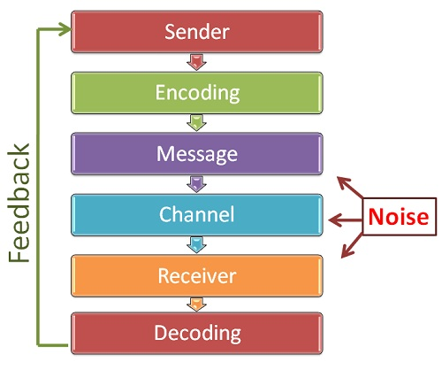
PROCESS OF COMMUNICATION

Slide 8

Sender- who takes steps to send the message to the recipient
Encoding- giving a form and meaning to the message through expressing it into words, symbols, gestures, graphs, drawings etc.
Medium- it is the method or channel through which the message is to be conveyed to the recipient. It can be oral or written or formal or informal.
Decoding- is it the act of converting the signs, symbols into meaningful statements as per the intentions of the sender.
Receiver- the person who receives the message.
Feedback- it is the reaction or response of the receiver to the message. The com process is complete when the sender gets feedback from the receiver.
Message- it is the subject matter of com. It may consist of certain facts ideas, opinions, grievances etc.

Slide 9
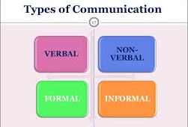

Slide 10
TYPES OF COMMUNICATION
Formal Communication: it follows in a formal manner. It follows the hierarchy. Information that officially reaches an employee is known as formal com. For example: policy manuals, orders, circulars, notices etc.
Features:
-This information is always authentic. -Always written form
-Proof of receiving the information is obtained
Advantages:
-It is official and reliable,-It is proper and systematic
-It serves as a evidence in future,-It fires responsibilities to the sender and receiver
Disadvantages:
-It is very slow, reaches person to person, takes more time
-It takes lot of time to prepare, to be typed and signed by concerned persons.

Slide 11
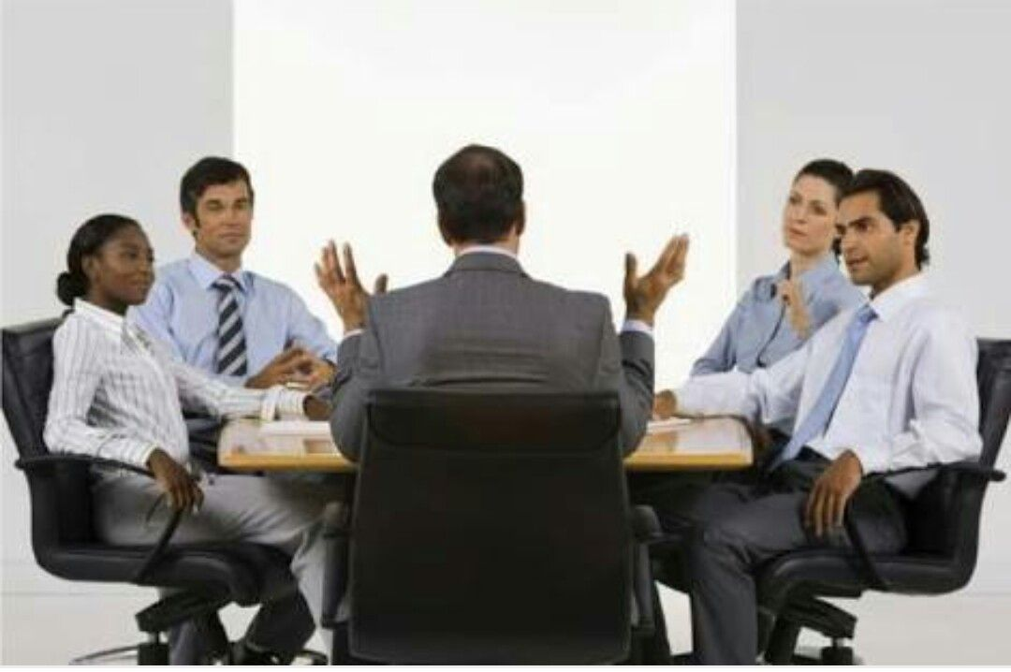

Slide 12
DOWNWARDS COMMUNICATION
Moves downwards in an organization , from the top mgmt to middle and lower level managements.
The forms of downward com are:
Orders and instructions about job
policy statements
Procedures and clarifications
Feedback on performance
Newsletters, memos, circulars
Annual reports

Slide 13
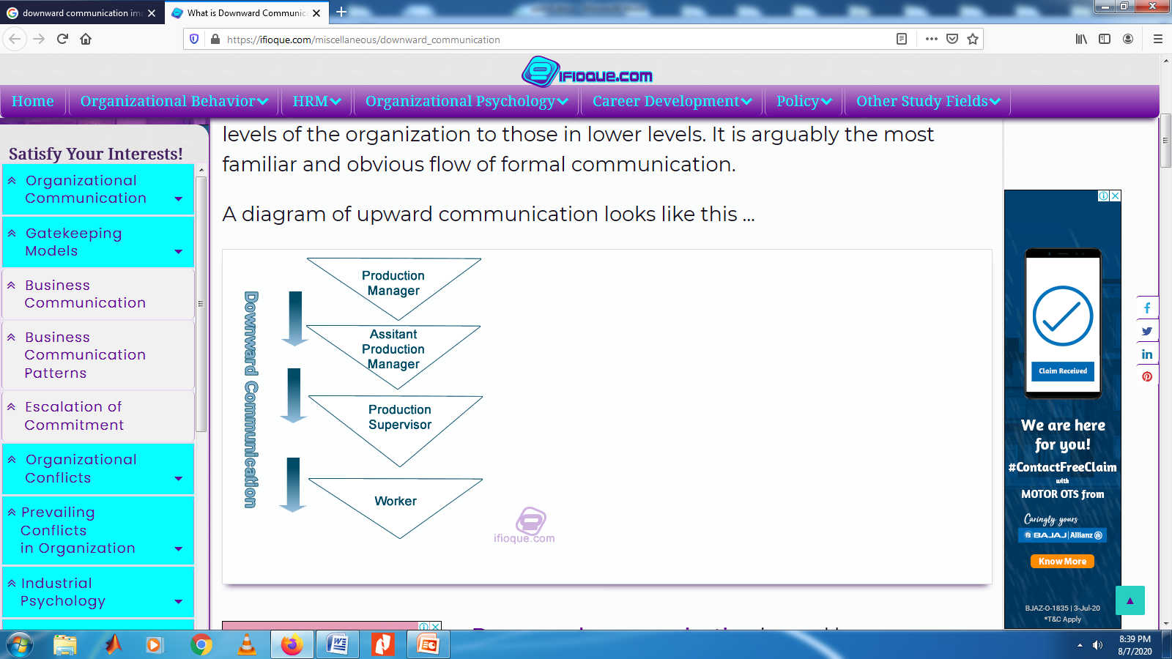

Slide 14
UPWARDS COMMUNICATION
From lower level mgmt to middle and upper levels of management.
Upward Communication in the form of
Reports by subordinates to superiors on work performance
Grievances and complaints
Suggestions and ideas of subordinates to the top mgmt
clarifications requests or appeals

Slide 15
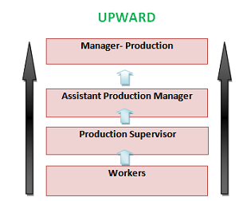

Slide 16
Sideward or horizontal Communication: this communication takes place among mgrs placed at same rank in the org.

Slide 17
INFORMAL COMMUNICATION
It is the result of casual or personal contact between the individuals in an org. Information that unofficially reaches an employee is called informal com. It also known as grapevine com. It spreads like grape plant.
Features of informal com:
it is verbally transmitted
it does not follow scalar chain
the information are not officially received
proof of receiving the information is not available
Advantages:
It is very fast, It provides mental relief to employees who wait for formal announcement.

Slide 18


Slide 19
DISADVANTAGES
It gives scope for rumors
The information is not authentic, so the employees cannot act against it
It also gets altered and twisted
It origin cannot be traced
It leaks out information which should be kept confidential
Rumour is grapevine information which is communicated without authentic stds of evidence. It is generally incorrect information.

Slide 20
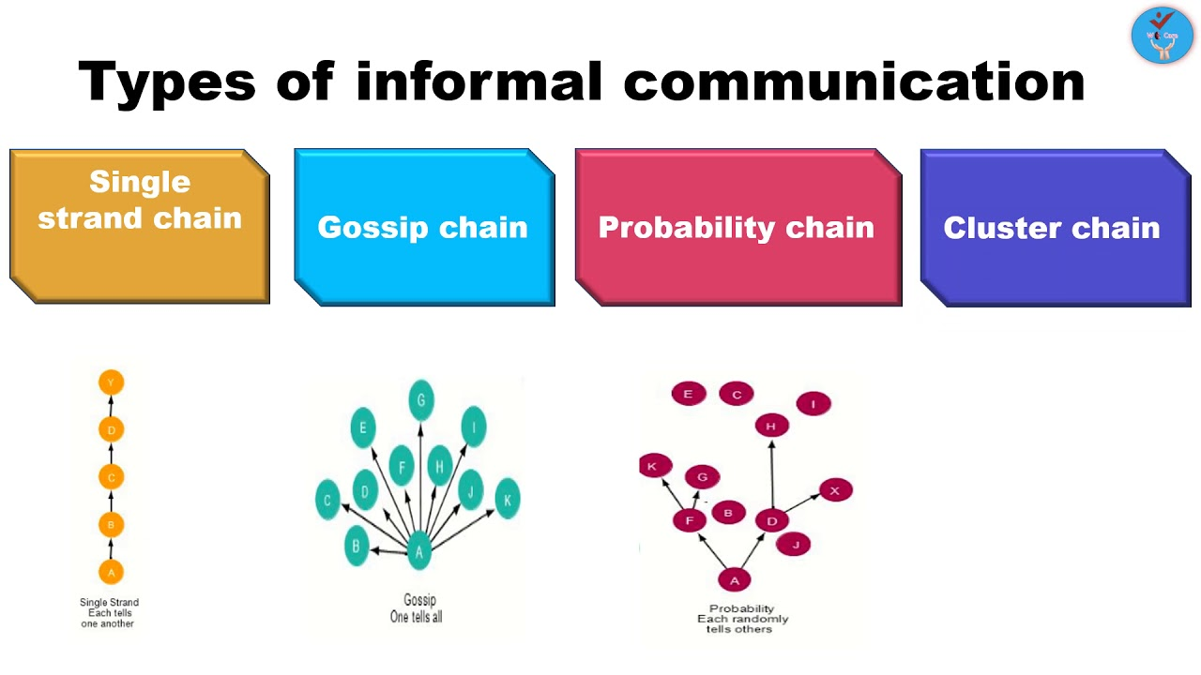

Slide 21
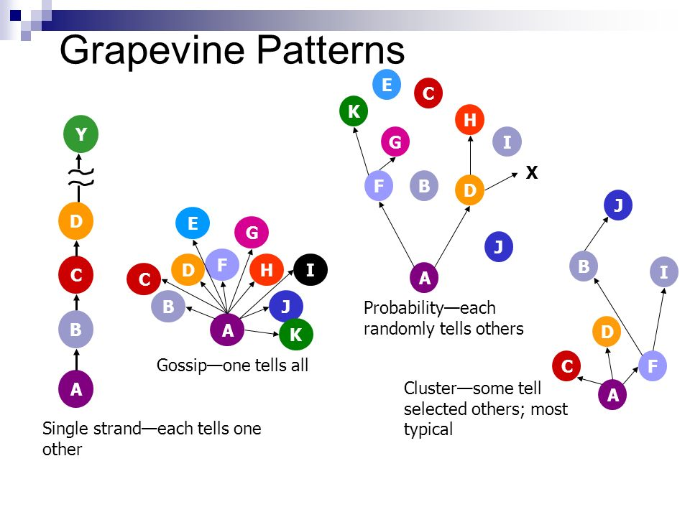

Slide 22
Formal | Informal
Formal Communication follows the officially established chain of command it is a slow moving process It is easy to pinpoint the responsibility with respect to formal com It consist mainly of work related matters It is orderly and systematic in direction of flow It serves org needs | Informal Communication is independent of the authority relations it is a fast moving process it is not possible to fix the responsibility of informal com It may consist of work related as well as social related It is unsystematic in direction of flow It serves social needs of members of the org

Slide 23
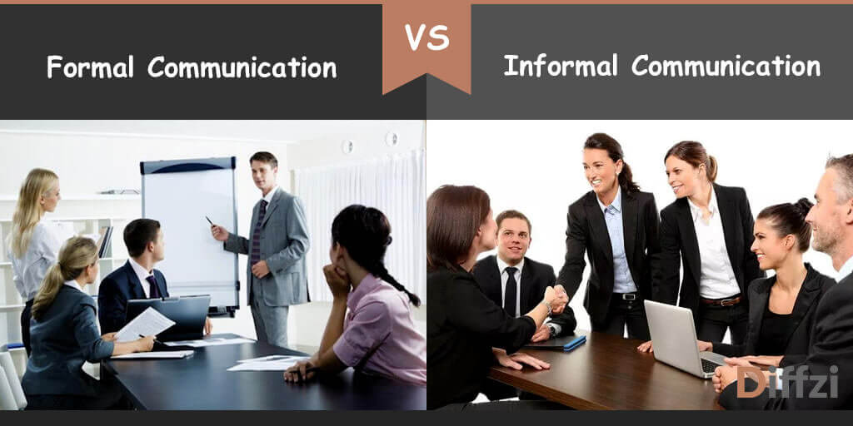

Slide 24
Oral Communication or verbal Communication: is a way of transmitting messages through words spoken by the sender of com to the recipient.
Face to face conversation: it takes place between two or more persons
Meetings: arranged to discuss certain issues like work related
conversation through telephone, mobile phone: it makes it possible to talk to anyone at any place
Intercom: it enables the employee to talk to another employee in the same premises
Internet chat: they require amplifier, internet, headphone, mike and even web camera to see their face

Slide 25
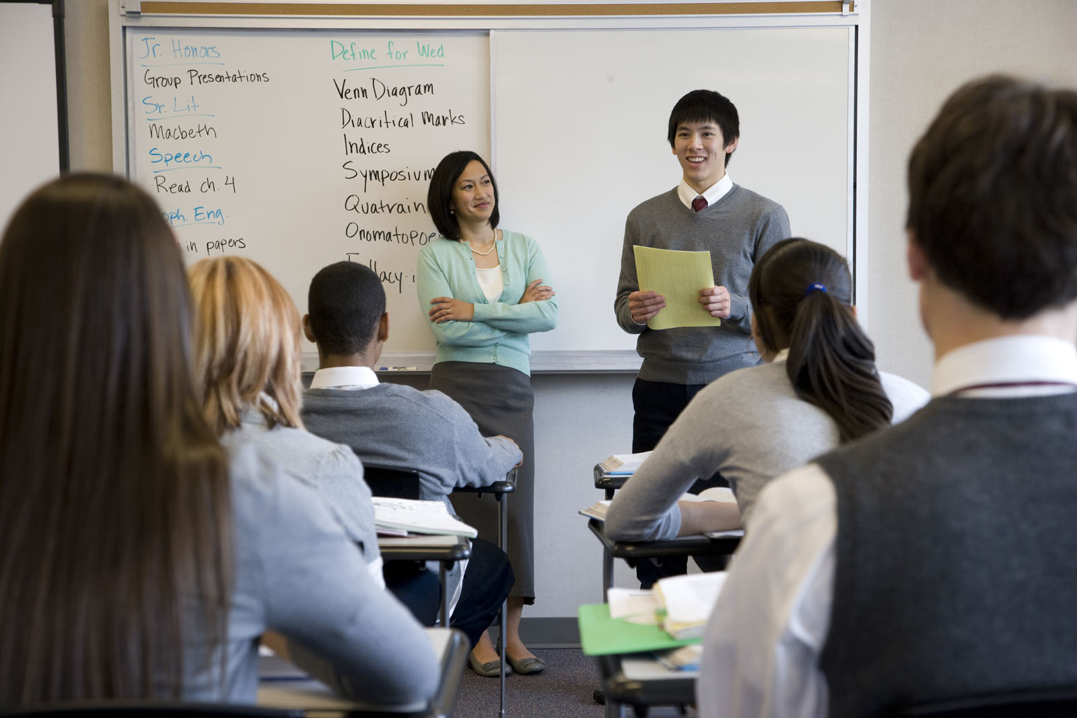

Slide 26
Advantages:
Since both are directly involved in conversation it is possible to exchange and clarify their ideas effectively
It is a very fast method,
It is not expensive
They can clarify the doubt immediately
Both the parties can see the reaction of opposite parties
It is ideal to communicate to 1000 of persons at a time
It is best method to solve the conflicts in two parties
It is best method to take decisions immediately
Disadvantages:
This cannot be preserved for future reference
Information orally passed may be altered or twisted later
There is possibility to misunderstand the oral information
Lack of attention on the part of receiver may make oral com a failure

Slide 27
Written Communication: by which the communicator establishes a direct contact with the receiver through written documents. It is a formal method of communication in the form of letter, memos circulars, reports, instruction cards, manuals, magazines etc.
Advantages:
It can be sent to anywhere in the world
It is always preserved for future reference
Produced as evidence in any court
It is very clear and accurate
It is ideal where it is unnecessary to have direct contact with the receiver

Slide 28


Slide 29
Disadvantages:
It is time consuming for preparation
there may be delay in reaching the letter to receiver
immediate clarification is not possible
difficult to maintain secrecy
sender cannot see the reaction of the receiver
if the sender uses hard vocabulary then it is difficult to understand

Slide 30
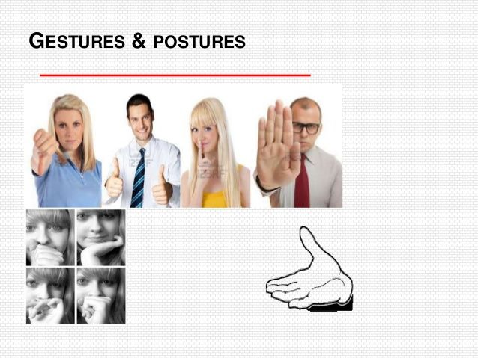
Gesture communication: actions such as nodding the head, rolling of eyes, movement of lips etc to convey some idea.

Slide 31


Slide 32
PERSONAL BARRIERS
Lack of command over language:
if a person is poor in conveying his ideas verbally or in writing due to lack of command over language then the com will be failure
Lack of self confidence
Lack of good vocabulary
Lack of fluency in language
Illegible handwriting
Lack of attention or interest
Tendency to make premature conclusions
Lack of confidence in the other party
Improper state of mind
Faulty pronunciation
limited retention capacity- memory

Slide 33
TECHNICAL OR MECHANICAL BARRIERS
Distortion-
In case of telephone conversation, cross talk can lead to distortion
In case of cell phone bad signal will create distortion
When a person uses mike in a meeting then electrical disturbance
Filtering:
when a message passes through different individuals it may be altered or twisted by persons for personal gain, due to long chain of communication
Overloading:
For Example the hard disc in the computer has its own storage space, accordingly we should send
Faulty equipment:
Can be affected due to fault on the equipment
For Eg. if the telephone or the fax is out of order it will affect transmission

Slide 34
ORGANIZATIONAL BARRIERS
Inadequate facilities:
Organization expected to give number of devices for communication like phone, cell, fax, internet and so on
Organization which is not giving these facilities becomes ineffective communication
Too much reliance on formal communication:
Organization depends on formal communication
Results in delay in sending and receiving any information
Status patterns:
Executives by their position in the organization
Enjoy greater comforts. Like separate air-conditioned room, personal phone, special furniture and so on
Makes a distance from their subordinates
Procedure delay:
Unwanted procedures laid down in certain organization contribute to delay in sending and receiving information

Slide 35
MEASURES TO OVERCOME BARRIERS
Overcoming personal barriers – by developing language
Shorter communication channels- in order to avoid delay
Use of electronic devices – fax, internet, mobile
Removing mechanical defects - proper working conditions
Development of listening habits - both the parties
Organizing frequent meeting and conferences - to express their views
mutual trust – confidence

Slide 36
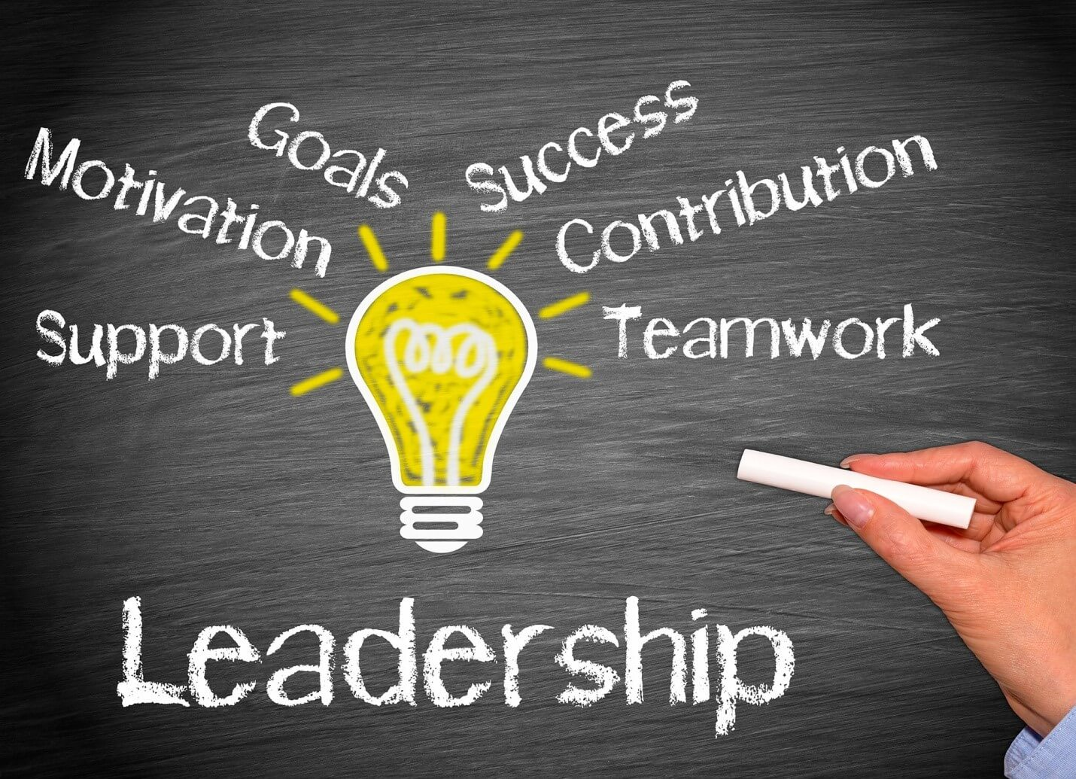
LEADERSHIP
A leader is a person who guides and directs others called followers
Focus to the efforts of his followers
Manager, as a leader, influences his subordinates to indulge in such activities as are vital for accomplishment of the enterprise goal
According to Allen, “a leader is one who guides and directs other people. He must give effective direction and purpose”
Leadership is a force that binds a group together and motivates it towards the desired goals

Slide 37
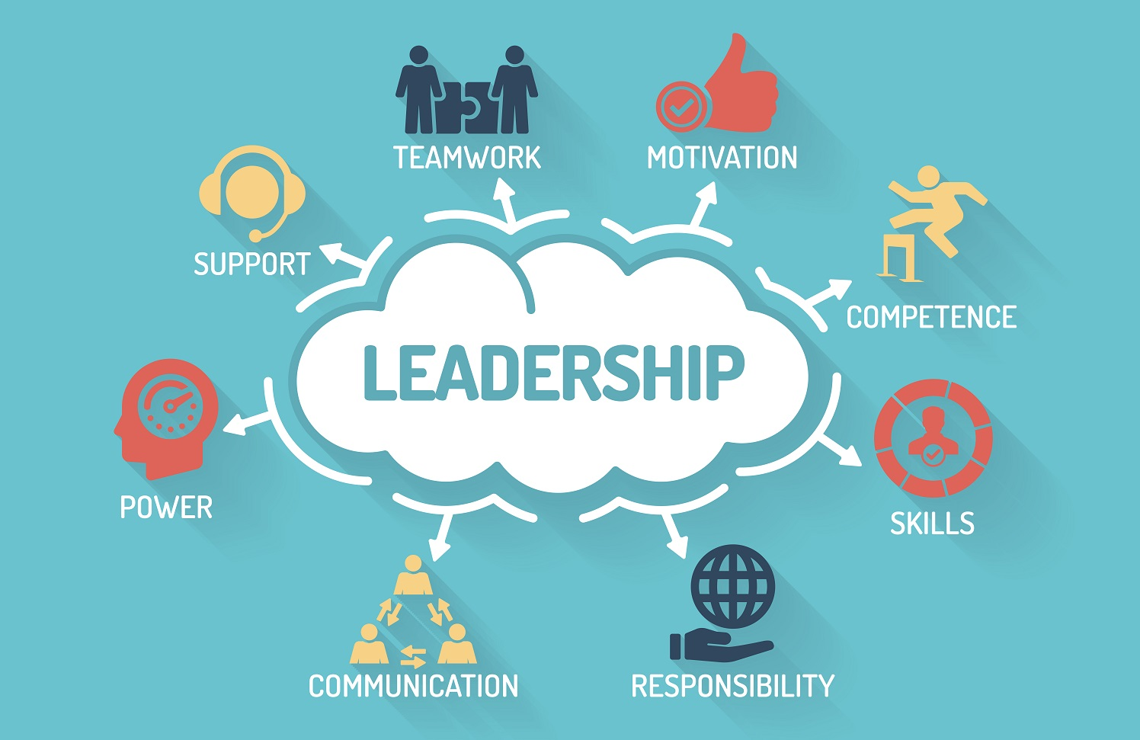
LEADERSHIP
Leadership is the ability of the manager to induce subordinates to work with confidence and zeal – koontz and o’donnell
Leadership is the ability of a superior to influence the behavior of his subordinates and persuade them to follow a particular course of action – Chester Barnard
Leadership is the activity of influencing people to strive willingly for mutual objectives –George R. Terry

Slide 38
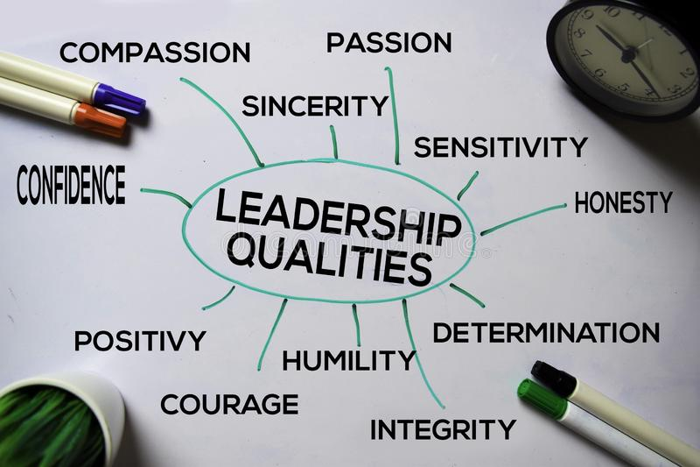
LEADERSHIP
Leadership is the process by which an executive imaginatively directs, guides and influence the work of others in choosing and attaining specified goals – Theo Haimann.
Leadership is a process of influence on a group in a particular situation at a given point of time and in a specific set of circumstances that stimulates people to strive willingly to attain organizational objectives – James gibbon.
Definitions that leadership is the act of guiding and directing the subordinates in order to attain the desired goal

Slide 39
NATURE AND CHARACTERISTICS OF LEADERSHIP
Personal quality of a person : An in born or an inherent quality of a person. It is also possible to train a person to acquire leadership qualities.
Process of influencing others: Leadership is the process of influencing others to act. In an enterprise, the manager has to get things done by his subordinates. For this, he has to influence their beliefs, behavior and attitudes.
Requires the confidence of the followers/subordinates: Accepted as a leader, the manager must gain the confidence of the subordinates. For this, he must be very knowledgeable, sincere and committed to his work. He must be a role model for his subordinates.
Motivation for subordinates : Leader is expected to motivate or induce his subordinates to work. He has to motivate the subordinates to put in efforts. Motivation need not always be in the form of offering certain monetary benefits. Even a word of appreciation may induce the subordinates to work hard.
Varying leadership styles: Style of leadership varies from person to person. Some managers are, by nature, democratic leaders while there are others who may follow the autocratic style of leadership
Leadership is a continuous process: Process of leadership is always necessary in an organization. The subordinates need to be guided, influenced, controlled and induced to work continuously for the attainment of the organizational goal.

Slide 40
FUNCTIONS OF LEADERSHIP
To have team work – leadership makes it possible for the employees to forget their individual differences and work as a team for the attainment of the organizational objective
To guide – although the subordinates have potentials, they need to be properly guide to contribute their best. The leader knows how to get optimum performance from each of the subordinates working under him
To motivate- leadership is necessary to induce subordinates to put in greater efforts. The leader constantly motivates his subordinates to work for achieving the organizational goal
To bring about changes – any organization has to be dynamic to accept changes caused by political, economic, technological and scientific factors
To handle crisis – leadership is necessary to handle crisis of any kind. When an organization faces a critical situation, the leader knows how to come out of it

Slide 41
LEADER AND A MANAGER
LEADER | MANAGER
A person becomes a leader by virtue of his personal qualities | A person becomes a manager by virtue of his official authority
A leader has followers | A manager has subordinates
The relationship between a leader and his followers is generally informal | The relationship between a manager and a subordinate is formal
A leader may strive for personal goals | A manager has to strive to attain the organizational goals
Leadership is the part of management. A person with leadership qualities may not always be a manager of an enterprise | Management is not a part of leadership. A manager is a leader in view of his formal authority
Leadership qualities are to a greater extent inherent or in-born | Managerial qualities are acquired
Leadership is possible both in formal and informal groups | Management is possible only in a formal structure.

Slide 42
QUALITIES OF A LEADER
Ability to analyse - the leader must be able to analyse any problem and offer an immediate solution. He should be alert mentally.
Emotional stability – the leader must not take any decisions influenced by emotions. He has to face any problem intellectually and find a solution.
Self-confidence – a person cannot be a successful leader if he lacks self-confidence. If he has confidence in himself, he will be able to overcome resistance from any of his proposals.
Foresight – the leader must foresee what is likely to happen. He must be able to visualize the future events and prepare his followers to meet challenges
Sense of judgment – the leader must be able to judge what is good under the given circumstances. Only then he will be able to evolve certain practical decisions.

Slide 43
QUALITIES OF A LEADER
Understanding – the leader must not always trust his views on his followers. He must also listen to their viewpoints particularly while making decision in a critical situation.
Mental courage – the leader must be capable of taking certain bold decisions. For this he must have mental courage. He need not play safe by just endorsing the decisions of others.
Capacity to motivate – needless to say, the leader must be able to induce and motivate his followers to work for the mission he has undertaken.
Ability to guide – the leader will be able to guide his followers in the work process only if he himself is well versed in the actual work.
Communication skills – successful leaders are always known for the communication skills. Such skills are essential to direct the followers to work for attaining the desired goal. Moreover, the leader will always be able to defend himself if he possess good communication ability.

Slide 44
QUALITIES OF A LEADER
Sociability – the leader should not be indifferent to the need of his followers work wholeheartedly for fulfilling his mission, If any follower has certain personal problems, the leader must do his best to help him.
Sound physical health – the leader must possess physical health. Mental health, If only the leader has the sound physical health.
Practicing what is preached – the leader must be a person who practices what he preaches. He can talk of commitment to work only if he himself is committed to work.
Ambitious –the leader must always be an ambitious person. Only then his subordinate will be able to work with enthusiasm. He must always have some novel plans to make things interesting for the followers.
Positive thinking – the leader must be an optimist. He must always have a positive attitude towards his work.

Slide 45
FUNCTIONS OF A LEADER
Planning – he has to prepare suitable plans for the effective functioning of his group/organization. Planning enables his followers to work for the attainment of the desired goal in a systematic manner.
Policy-making – the leader has to evolve suitable policies that guide his group in arriving at decisions.
Execution of plans and policies –The leader has to instigate his followers to work in accordance with the plans and policies in order to achieve the desired goal.
Controlling internal relations – the leader has to ensure that there is cordial relations among his group members and that they work in an atmosphere of proper co-operation and co-ordination.
Representing the group – the leader has to represent his group both within and outside the organization and convey the feelings, sentiments and the stand of his group on important issues.

Slide 46
FUNCTIONS OF A LEADER
Providing reward and punishment – if any subordinate has to performed his task well and is sincere and committed to work, the leader shall reward such a person suitably.
Settlement of disputes – the leader has the duty to amicably settle any dispute between him and his group members and also among the group members.
Role-model – the leader must set an example to his followers. He must practice what he preaches. He must say what he does and do what he says.
Answerability – the leader becomes accountable or answerable not only for his actions but also those of his followers.

Slide 47
DIFFERENT KINDS OF LEADERSHIP STYLES
1. Autocratic
2. Democratic
3. Laissez faire
4. Functional
5. Institutional and
6. Paternalistic

Slide 48
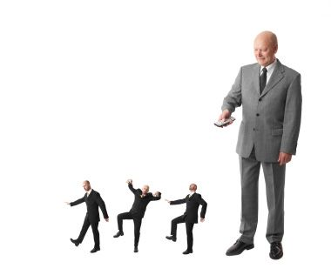
AUTOCRATIC
An autocratic leader wants his subordinates to work in the manner he wants
Tells them what they should do, he does not let his followers offer any suggestion
Specifies the goal, makes available the resources that he thinks are enough and sets the deadline within which the subordinates will have to complete the task
Subordinates have to report to him at regular intervals to show the progress of work

Slide 49
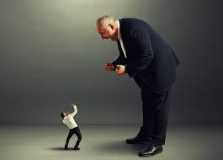
AUTOCRATIC
Autocratic leader thinks that his subordinates are incapable of making decisions
A subordinate, who performs as per the specifications of the leader, is rewarded while the one who fails to perform is punished
Punishment may be in the form of fines, suspension, transfer, demotion or dismissal
Autocratic leader does not have confidence on his subordinates
He thinks that they are basically lazy, have an inherent dislike for work and are not ambitious and creative

Slide 50
AUTOCRATIC
MERITS:
Such a leadership style is suitable when subordinates are lazy and shirking duties
Helps to make quick decisions
As subordinate are under constant threat of disciplinary action, they are always cautious
Inefficient and insincere workers can be easily identified and removed from service
DEMERITS:
Subordinates normally show resistance to this type of leadership style as it curtails their freedom to act
Kills initiative for work and results in frustration among workers
Often gives scope for conflicts between the leader and his followers which is bad for the organization
At some stage, the subordinates may stop obeying the orders of the leader and start showing their protest. If such a stage is reached, the leader will become helpless

Slide 51
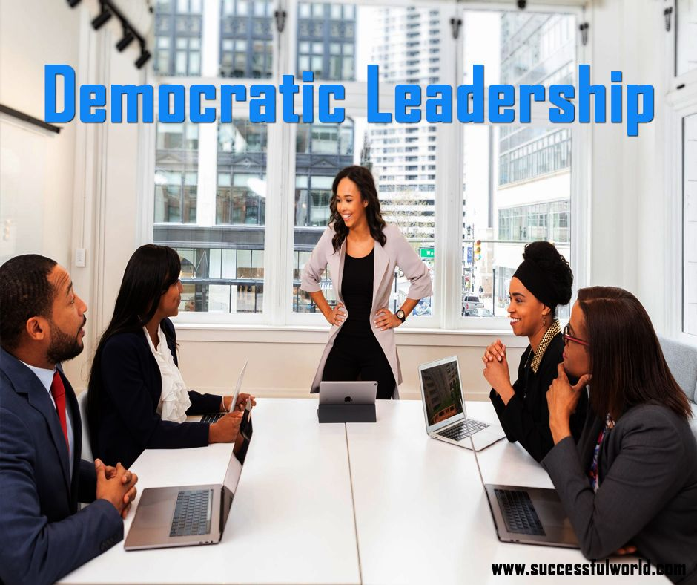
DEMOCRATIC
A style of leadership is also known as ‘participative leadership’
A democratic leader does not make unilateral or one-sided decisions
He provides scope for his followers to participate in the decision making process
He allows the subordinates to discuss the problems
The final decisions will be made based on the consensus of all
If any subordinate does anything that is opposed to the interest of their group, the other members of the group take the initiative to correct him

Slide 52

DEMOCRATIC
MERITS:
1. As the followers are able to participate in the decision making process, they feel motivated.
2. The decision finally made is mutually acceptable. The followers, therefore, work for its implementation wholeheartedly.
3. There is no resistance from the subordinates.
4. It improves the job attitudes of the subordinate staff
5. As the subordinates do not have ill feelings of any kind, the labor management relationship is bound to improve.

Slide 53
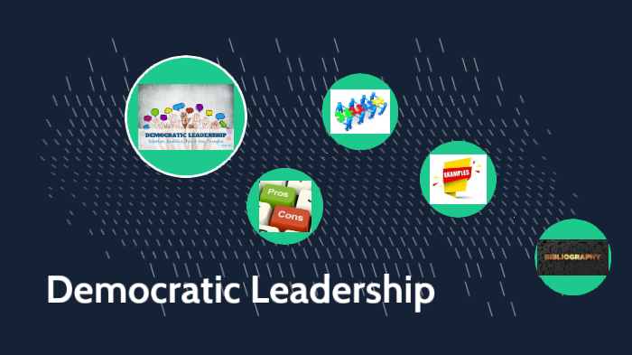
DEMOCRATIC
DEMERITS:
1. There may be delay in arriving at a decision,
2. Democratic leadership is suitable only if the subordinates are capable of making worthwhile suggestions.
3. It may, sometimes be very difficult to evolve a solution that is acceptable to everyone.

Slide 54

LAISSEZ FAIRE LEADER
Also known as ‘Free Rein Leader’ a laissez faire leader gives full freedom to his followers to act
He does not lie down guidelines within which his followers have to work
He neither influences his subordinates’ decisions nor does he interfere in the process of decision making
Laissez faire leader does not exercise the formal authority of a leader
MERITS:
The subordinates have the full freedom to act, their level of motivation is bound to be very high.
Those subordinates, who are highly efficient, can make use of the freedom and they excel.
The superior-subordinate relationship is bound to be very good
DEMERITS:
This type of leadership provides good results only if the subordinates are highly efficient and capable of doing their work independently
As the leader does not involve himself at all in the activities of his subordinates, control may become difficult
The leader does not exercise his formal authority
As a result, the work place may lose its official character

Slide 55
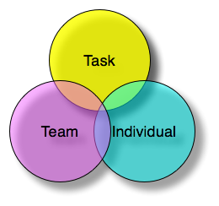
FUNCTIONAL LEADER
This leader is one who is an expert in a particularly field of activity
He has risen to the position of a leader by virtue of certain special skills that he possesses. He does not command any formal authority
Such a leader always thinks of the tasks he has undertaken and spends most of his time finding out ways and means of doing it better
The functional leader will be able to offer help to its subordinates provided the subordinates approach him for certain job related problems
The leader expects the subordinates to perform to his level and if the followers are not serious about their work, he may demand performance
MERITS
As the functional leader is an expert in a particular field of activity, the subordinates can certainly enrich their job knowledge and skill, provided they are as committed and sincere as their leader is.
DEMERITS
The functional leader is a taskmaster. He believes in work. The leader will not be able to go down to the level of an average worker and offer any help.
The leader may, sometimes, demand performance from his followers. This may frustrate them.

Slide 56
INSTITUTIONAL LEADER
An institutional leader is one who has become a. leader by virtue of his official position in the organizational hierarchy
For ex: a person appointed as the general manager of a concern
This type of leader may not be an expert in his field of activity
He, therefore, may not be able to provide expert guidance to his followers
But he has to secure performance from them
MERITS:
He has the official authority to act
He can demand performance from subordinates irrespective of his own credentials and the subordinates are officially answerable to him
DEMERITS:
As the institutional leader may not be an expert in his field of activity, he will not be in a position to offer guidance to his followers

Slide 57
PATERNALISTIC LEADER
Takes care of his followers in the way the head of the family takes care of the family members
Mainly concerned with the wellbeing of his followers and is always ready to protect them
May provide with all the physical amenities needed.
But he will not be able to guide them to perform well in their job.
Thus, the paternalistic leader is able to be sociable but is not able to offer intellectual help.
MERITS:
He assumes a paternal role to protect his subordinates
He is always ready to provide necessary amenities to the subordinates
DEMERITS:
He is not in a position to do intellectual help to his subordinates
Those followers, who are capable and achievement oriented, do feel frustrated, as the leader is not able to guide them to enrich their job knowledge and skill

Slide 58
THEORIES ON LEADERSHIP
Research studies were conducted to ascertain the emergence of leadership. The researchers wanted to find out the determinants of leadership. Three such determinants were studied, namely, the personality of a leader, his behavior and the situation. As a result the following three theories came:
1. Traits theory
2. The Behavioral theory
3. The situational theory

Slide 59
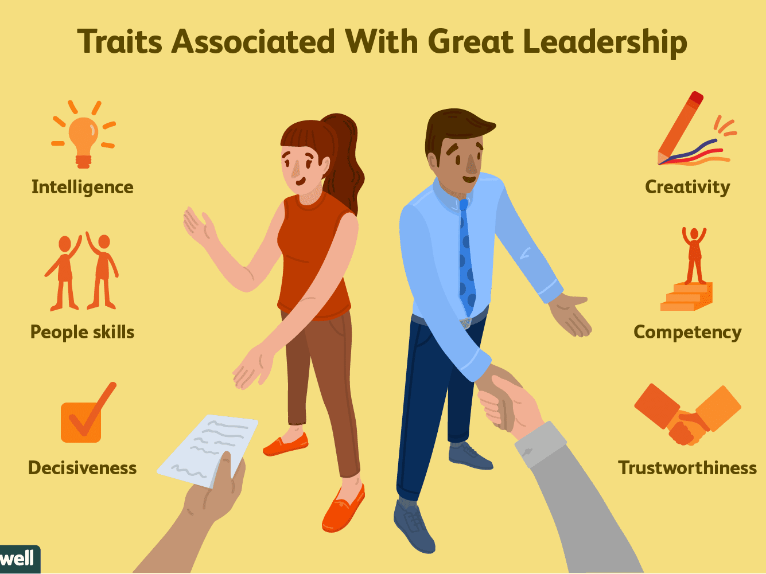
TRAIT THEORY
This theory is based on the assumption that a leader is a person who possesses certain exceptional traits or qualities. Many such traits or qualities were identified. Those, who were successful leaders in the past, were found to be having all such traits. These are:
1. Intelligence,
2. Knowledge
3. Communication skills
4. Initiative
5. Judgment
6. Sincerity
7. Inquisitiveness
8. Endurance
9. Integrity

Slide 60
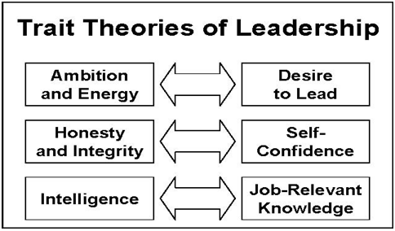
TRAIT THEORY
10. Determination
11. Emotional stability
12. Mental ability
13. Imagination
14. Persuasion
15. Courage
16. Physical appearance
A person with these qualities can certainly emerge as a successful leader. These qualities need not always be inborn. These can be acquired through proper training.

Slide 61

BEHAVIOURIAL THEORY
According to this theory, leadership depends more on the acts of the person than on his personality traits. The behavior of the person attracts many followers towards him. These followers are ready to accept him as their leader as they are influenced and impressed by his behavior.

Slide 62

EVALUATION OF BEHAVIORAL THEORY
This Behavioral theory is superior to trait theory in so far as it gives at most importance to what the leader does rather than what he is. But its main drawback is that it is not possible to determine the kind of behavior that will be ideal under all circumstances. A behavior that is effective at a particular point of time may not be so always.

Slide 63
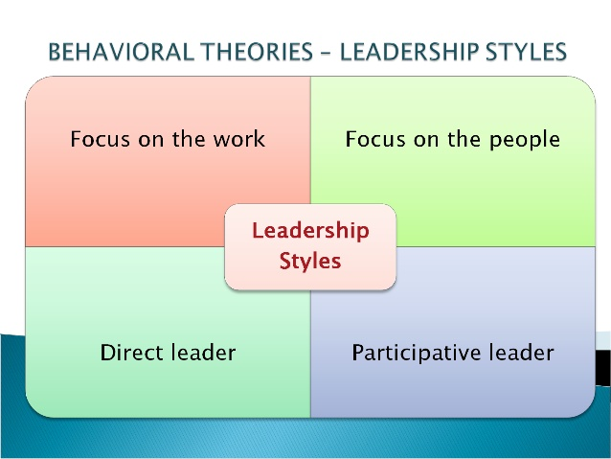
LEADERSHIP STYLES
According to this theory, leadership is much influenced by the environment or by the situation in which it is exercised. The style of leadership should change according to the situation.
It, therefore, becomes clear that there is no particular style of leadership that is
universally relevant. The leader, in order to be successful, should adapt him to the situation.

Slide 64
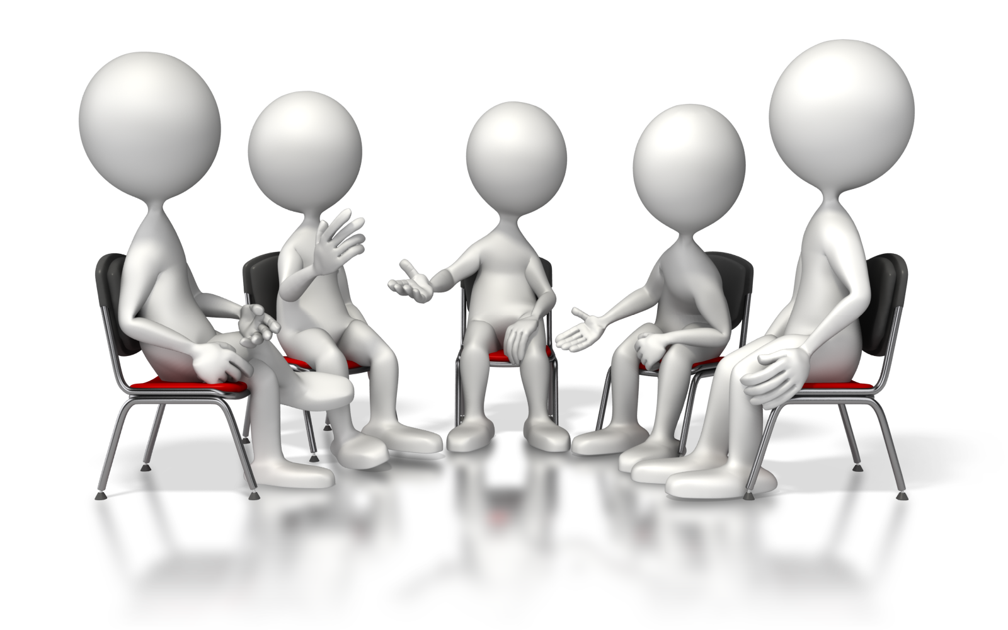
GROUP
A group is a cluster of persons who have come together to pursue activities of common interest. A group may consist of any no. of persons. But the group members must have continued interaction with and must be psychologically aware of one another.

Slide 65
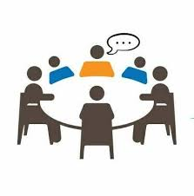
GROUP
According to Edgar Schein, “a group is an aggregation of people who interact with each other, are aware of one another, have a common objective, and perceive themselves to be a group”
CHARACTERISTICS OF A GROUP:
1. A group is always a conglomeration of persons
2. The members know and interact with one another
3. The members come together to pursue certain activities of common interest.
4. Each member perceives that he is a part of the group

Slide 66

WHY GROUPS ARE FORMED?
NEARNESS AND INTERACTION:
In the workplace, the employees work close to each other. During their course of work, they may have to interact with one another. Such an environment may induce them to form groups.
CAPACITY TO INFLUENCE:
To influence another by reason of work or work related
3. NEED FOR SECURITY:
One of the main reasons for the formation of group vision is the need for security. If the employer creates an environment in which the employees feel insecure, they have to come together as a group, namely, the union to safeguard their interests.

Slide 67


WHY GROUPS ARE FORMED?
4. COMMON INTEREST:
People with common interest, likes and dislikes often come together. The subject matter of interest may be something connected with their work or it can be anything like politics, sports, hobbies, etc.
5. RECOGNITION:
The recognition that is not normally available to a person when he is alone, A person who feels it all his endeavors must be recognized and appreciated will identify himself with some group in the organization.

Slide 68

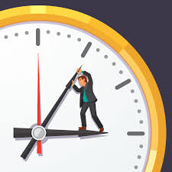
WHY GROUPS ARE FORMED?
POWER:
Employees derive much greater power collectively, i.e., as members of union, than as individuals. A small informal group gives an individual a feeling that the group will not let him down when he faces a crisis.
7. TO GET RID OF DELAY:
Formal organization promotes delay in view of hierarchy and longer channels of communication. To get rid of the delay in the completion of certain specific tasks,

Slide 69
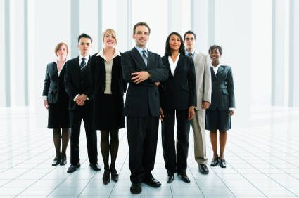
TYPES OF GROUPS
1. FORMAL GROUPS:
A group that is officially, deliberately and consciously created to perform certain tasks is known as a formal group. Such has a hierarchical structure. The members of the formal group are allotted definite task.
They have adhered to certain rules and regulations. A formal group is also known as a command group.
Formal groups can be permanent as well as temporary. Command groups and permanent committees are examples of permanent formal groups

Slide 70
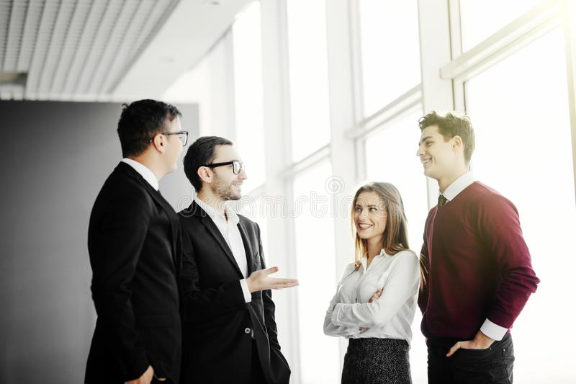
TYPES OF GROUPS
2. INFORMAL GROUPS:
An informal group is the one which is unofficially created. It rises owing to personal relationships between the individuals of the organization. Factors such as friendship, language, religion, etc., influence the formation of informal groups.
An informal group may sometimes perform a task that the formal group has failed to perform. In formal groups maintain and strength the values and beliefs of their members. They provide the feeling of security to the members and help them interact with one another. They further strive to solve their work-related problems.

Slide 71
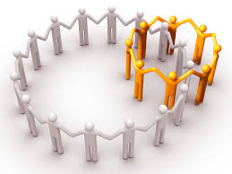


TYPES OF GROUPS
3. MEMBERSHIP GROUPS:
A membership group is one to which an individual actually belongs whether he is satisfied with the norms, values, beliefs and practices of such a group.
4. REFERENCE GROUPS:
A reference group is one with which the individual actually identifies himself. In other words he would like to be associated with such a group
5. IN-GROUP:
An in-group is one which we belong. The members of an in-group have certain values, beliefs, ideals, and norms that act as a binding force.

Slide 72
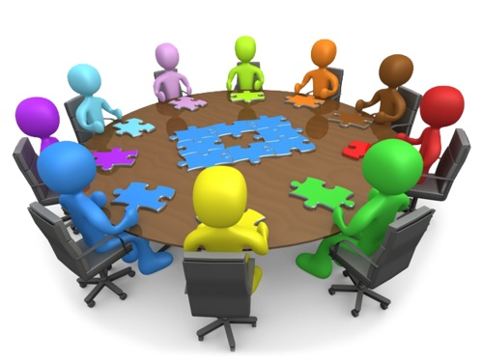
OPEN GROUP
An open group is the one that is in a constant state of change. Its membership keeps fluctuating, i.e., existing members may leave and new members may join. The group accepts the idea of the new members and may slowly give p certain old practices. In view of such a trend, the open group may have plans and proposals only for a shorter period of time.

Slide 73
GROUP COHESIVENESS
It refers to the extent to which the members of the group are attached to each other and willing to remain in the group.
FACTORS INFLUENCING COHESION
1. INTERACTION:
The extent to which the members of the group interact with each other determines group cohesion. Differences of opinion are bound to rise in any workplace. Such differences have to be sorted out through discussions and deliberations. The greater the interaction among the group members the better will be the cohesiveness.
2. THREAT:
The kind of threat the members face both from internal and external environments can influence group cohesion. The greater the threat the better will be the cohesiveness.
3. LEADERSHIP:
The quality of leadership can be an important determinant. If the leader is capable, he will be able to secure cohesion easily among members.

Slide 74

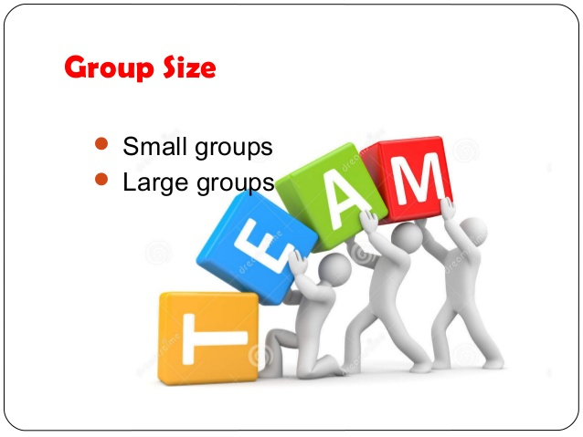
GROUP COHESIVENESS
4. VALUES:
The extent to which the group members share their values and attitudes is another determinant. If every member starts acting as per his value system, securing group cohesiveness will become difficult.
5. SIZE OF THE GROUP:
The size of the group can be yet another important determining factor. When the size of the group increases, securing cohesion among members will become difficult.

Slide 75
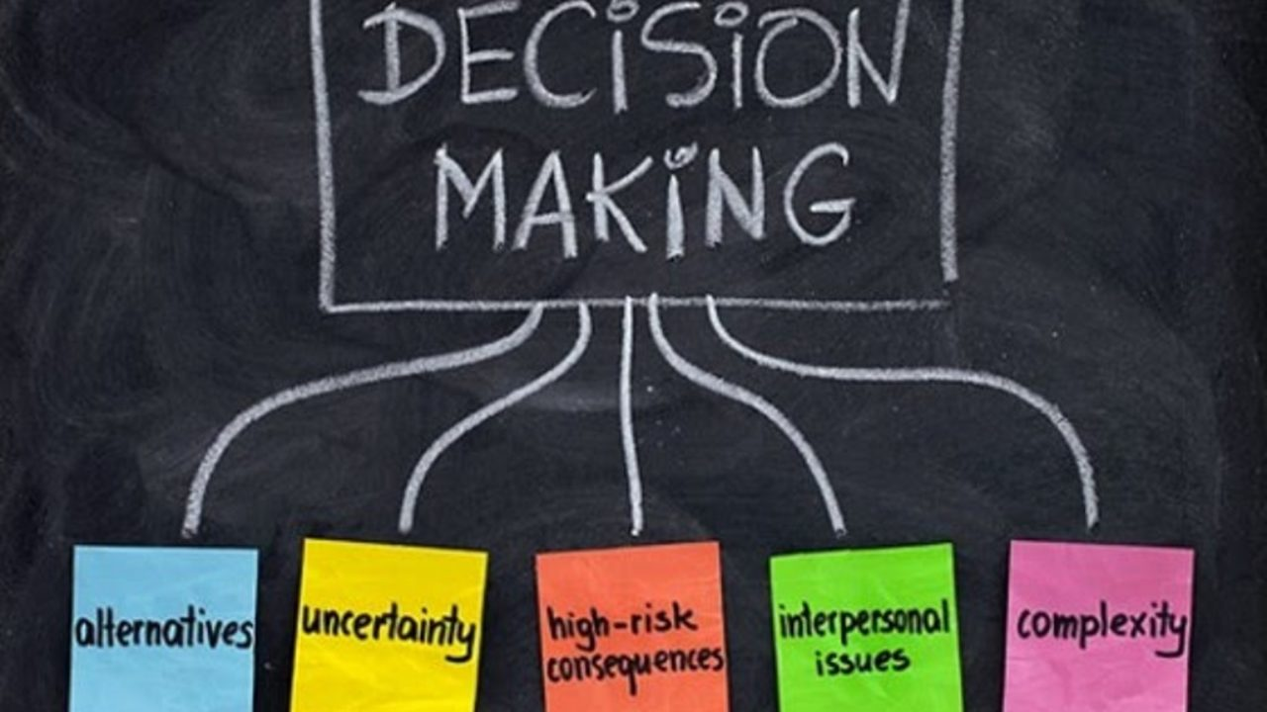
DECISION MAKING
Decision making is the process of selecting one alternative from a no. of alternatives available
Need for decision making will arise only when there are options
If there is only one way of doing a task, there is nothing to decide
George Terry, ‘decision making is the selecting of an alternative, from two or more alternatives, to determine an opinion or a course.”

Slide 76
PROCESS OF DECISION MAKING
1. IDENTIFYING AND UNDERSTANDING THE PROBLEM:
The first step in the process of decision making is to identify and understand the actual problem. If the actual problem is identified, it will be possible to provide remedy by evolving a suitable decision.
2. MAKING AN ANALYSIS OF THE PROBLEM:
Once the actual problem is identified, the next step is to make a detailed analysis of the same. Analysis of the problem requires data that may be obtained from both internal and external sources.
3. IDENTIFYING ALTERNATIVE SOLUTION:
After the problem has been analyzed in detail, the next step is to develop alternative solutions. Any organizational problem has many solutions. It is, therefore, necessary that the decision maker identifies the alternative solutions.

Slide 77
PROCESS OF DECISION MAKING
4. EVALUATING THE ALTERNATIVE SOLUTION:
After the alternative solutions have been identified, the next step is to make an evaluation of the same. Evaluation of alternatives is done by seeing the pros and cons of the alternatives.
5. SELECTING THE BEST SOLUTION:
At this stage the solution considered the best and the most viable one, under the circumstances, are selected. In addition to the merits of each alternative solution, the following factors too influence the selection the best alternative:
· Resources available
· The values and beliefs of the decision maker
· Opinions of the staff.
6. IMPLEMENTING THE DECISION:
After the final decision has been made, the next step is to implement the same. Implementing the decision is done by communicating the same to all concerned.
7. REVIEW:
Periodic review of the decision, This is done by comparing the actual results with the expected results. Deviations, if any, must be noticed and corrective measures must be taken then and there. Certain modifications or alterations in the decision may be made if necessary.

Slide 78

GROUP DECISION
These are decisions made by the group of persons
In an organization, there may exist a committee consisting of the representatives of both the worker and the management
When there is a dispute between the workers and the management, the mater will be referred to the committee
The committee may conduct an enquiry and announce its decision which is binding on both the workers and the management

Slide 79
GROUP DECISION
MERITS OF GROUP DECISIONS:
1. Every member of the group will come out with his views on the problem considered. The problem, therefore, can be thoroughly discussed and the best solution can be found out.
The decision of the group, usually, will not be a biased one. This is because; every member of the group has his own ideals and values.
3. The group usually consists of members who represent different segments of the organization. Therefore, each member will ensure that injustice is not done to the segment he represents.
4. The process of group decision making also provides scope for proper co-ordination and co-operation among the members into confidence when he discusses any issue.
5. Group decisions enjoy a greater sense of acceptability than individual decisions.

Slide 80
GROUP DECISION
DEMERITS OF GROUP DECISIONS:
There may be delay in arriving at a decision.
There is no fixed responsibility on any member of the group for the quality of the decision made..
Group decisions are often found to be compromise decisions. This happens because the members may give divergent views on the issue and the consensus has to be reached somehow at the end.
It is also possible that a few influential members of the group may try to put pressures on others and get their consent.
Group decisions are always expensive compared to individual decisions in terms of time, money and efforts required.
Conflicts may also arise between the members of the group.

Slide 81
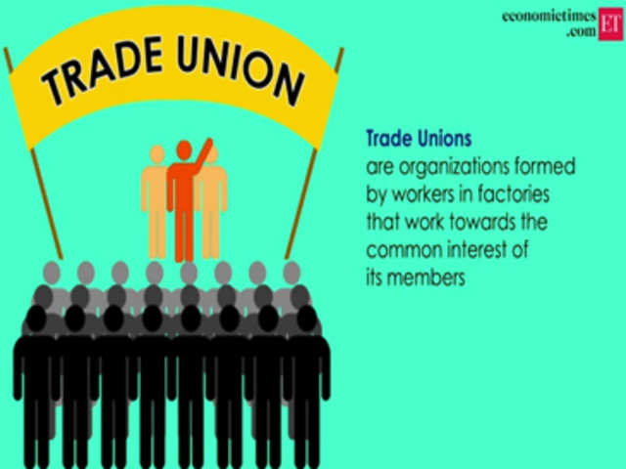

Slide 82

TRADE UNION
Meaning:
“It is essentially an association of employees of a particular trade or industry formed to safeguard the interests of its members against certain vindictive management actions.”
Definition:
A trade union is a continuing, long term association of employees, formed and maintained for the specific purpose of advancing and protecting the interests of members in their working relationships. -Dale Yoder

Slide 83
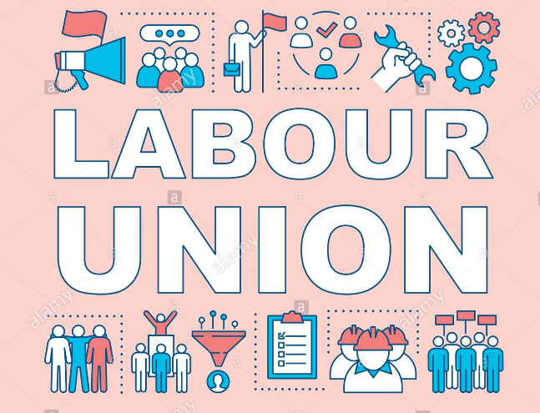
LABOUR UNION
According to Edwin B. Flippo “a labour union or trade union is an organization of workers formed to promote, protect and improve, through collective action the social, economic, and political interests of its members.” The economic aspect relates to wages, hours of work, working conditions, etc.

Slide 84
CHARACTERISTICTICS OF TRADE UNION
Association of employees: Belonging to a particular class of employment, profession, trade or industry. E.g. Trade union for teachers, doctors etc.
Voluntary association: An employee joins the trade union out of his freewill.
Permanent body: Members may come and go but the trade union remains.
Common interest: The members have common interest. Job security, better pay and working conditions.
Collective action: Collectively take action
6. Rapport with the management: The officials hold talks with the members of the management.

Slide 85

NEED FOR TRADE UNION
To ensure job security and right pay for the members.
To ventilate the grievances of employees to the management.
To have better bargaining power.
To secure better conditions of service.
To participate in management decisions.

Slide 86
FUNCTIONS OF TRADE UNION
Safeguarding the interest of employees: It ensures job security for every employee.
Ensuring better working and living conditions: Fair wages, incentives, bonus, medical facilities, etc.
Securing promotion and training opportunities
Redressing grievances: Whenever an employee has any grievance over the actions of the management, he brings it to the notice of the union, the union takes up the issue with the management and finds a solution.
To do collective bargaining: with management on behalf of workmen
Participation in management decisions

Slide 87
Education: They may instigate the members to acquire higher qualifications
Recreation: Do organize sports and other recreational activities for their members.
Financial Assistance: Do financial help to their members during periods of strikes and lockout and also to any member undergoing medical treatment.
Conducting meetings: Meetings for office bearers at regular intervals to discuss any issue related to employees.
Distributing pamphlets, booklets: They bring out magazines and periodicals to enlighten the members.

Slide 88
Social service: They provide financial help by collecting contributions from the members to the victims of earthquake, floods and other natural calamity.
Political affiliation: They may seek the help of political parties to solve certain problems.
Organizing demonstrations: When the talks with the management fails, they organize demonstration, fasting, slogan shouting, etc.
Giving strike calls

Slide 89
WHY DO PEOPLE JOIN TRADE UNION
To protect themselves against exploitation by the management.
For acting as a counter weight of management.
To negotiate (wage payment, working conditions) policies.
To safeguard job security
To restrain management from talking illogical, unreasonable actions.
To project their view to management effectively.
For identification or identity
For prestige
To protect themselves from fellow workers
For emotional or psychological satisfaction

Slide 90
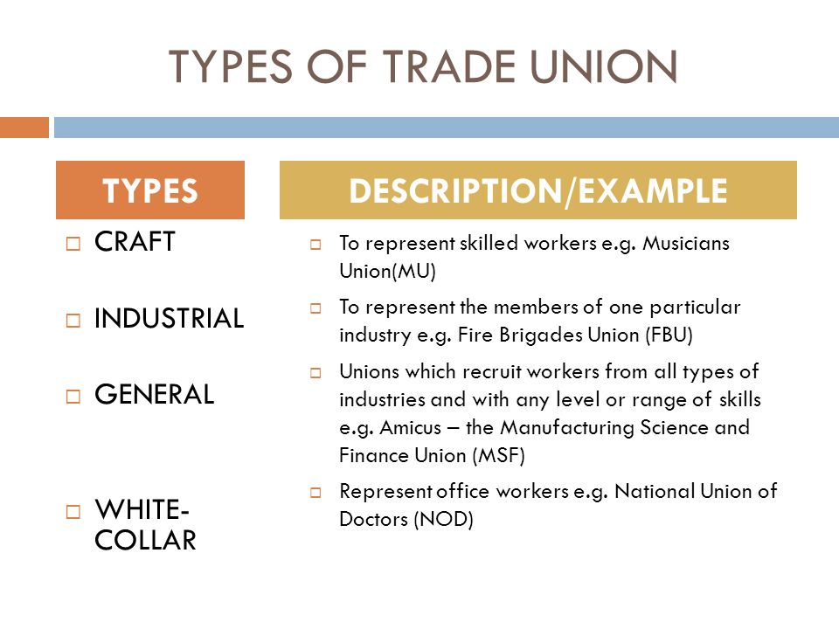
TYPES OF TRADE UNION

Slide 91
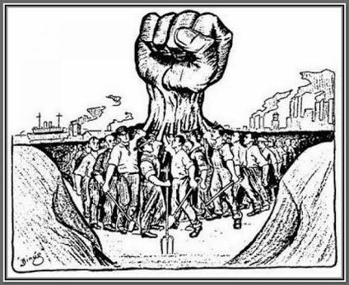
CRAFTS UNION
Workers belonging to a particular trade or craft organize themselves into a separate union.
They may be working in same or many different organizations.
E.g. The bank employees’ union doctors, lawyers’ association, teachers’ association
Advantages:
Better unity and identity
Better bargaining power
Great speed in organizing strikes
Not much damage to the general workman

Slide 92

INDUSTRIAL UNION
One union in work place or one union, one organization. It means all workmen of a particular organization or industry are members of one union.
They may be mechanics, office staff, accounts people, drivers, quality department staffs, electricians etc, one union, one industry. Ex Textile mill unions, steel industry unions,
Advantages:
Easy for management.
Decision binding everyone.
Very effective in all their activities.
Absence of multi union.

Slide 93

GENERAL UNION
All workmen from different types of organization but working in same industrial centre, town or a geographical area, form a common trade union.
It could comprise of manufacturing industries, banks and agriculture etc, Mostly for common objectives like environment and pollution, infrastructure facilities, water resources for developing the region. ex Peenya industrial workers’ union, Thane industry employees’ unions

Slide 94

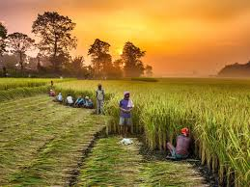
BLUE COLLAR UNION:
A blue collar workers like machine operators, electricians, workers in maintenance shops etc, (they are paid weekly) joined together form union called blue collar union.
WHITE COLLAR UNION:
They are like typists, clerks, computer operators, officers, bank employees, journalists, etc, (They are paid monthly) joined together form union called white collar union.
AGRICULTURAL LABOUR UNION:
This involves farm labor, dairy farms cultivators, household labor etc. form union

Slide 95
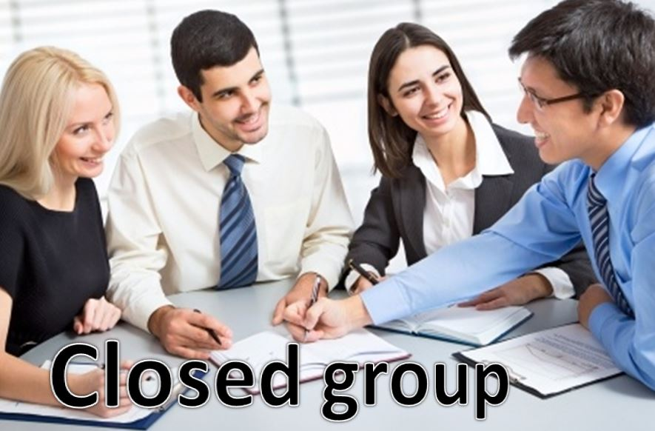

UNIONS CLASSIFIED BASED ON AGREEMENT
Closed shop:
In certain organization, union and management get into an agreement that only the union have the power to recruit the employees. This is called closed shop.
Union shop:
This is an agreement in which all new recruit must join the union within a fixed period say within 3 months. The management is free to select anyone to fill up the vacancy in which union cannot interfere.

Slide 96
iii Maintenance shop:
Here, there is no compulsory membership of union but if he join in union then his membership remain compulsory during the entire period of engagement.
iv open shop:
Membership of union is not compulsory.

Slide 97
UNIONS CLASSIFIED BASED ON MEMBERSHIP
QUALIFIED UNION:
A union having a membership of at least 5% of total number of employee in anyone industry is recognized as a qualified union.
REPRESENTATIVE UNION :
A union having a membership of at least 15% of total numbers of employee in anyone industry is recognized as a representative union.
PRIMARY UNION:
A union having a membership of more than 15% of total number of employees employed in any one industry is a recognized as primary union.

Slide 98
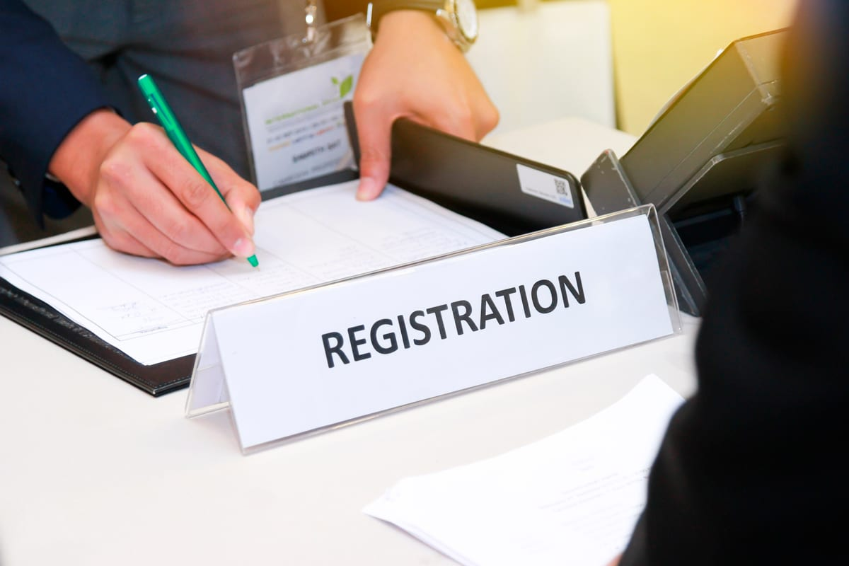
REGISTRATION OF TRADE UNION
To start union trade any 7 or more members needed.
The application for registration shall be made to the register of trade union who is appointed by the state government.
The application must sent along with the names, occupation and addresses of the members making the application.
The name of the trade union and the address of its head office.
Purpose for which general funds could be applied
Members from 15-18 age. (above 18 can be office bearer)
Subscription details
Procedure for appointment of office bearers

Slide 99
PROBLEMS OF TRADE UNION
MULTIPLICITY OF UNIONS:
Existence of many unions trying to compete with each other on membership.
It creates inter union rivalry and disunity among the workers.
If one union comes out with a strike proposal another union may work against it, As a result, none of the union is actually able to solve the problems of the workers
2. LACK OF BALANCED GROWTH:
Trade unions are associated with big industrial houses.
The entire agricultural sector is highly unorganized and no unions in small scale sectors.
Lack of balanced growth of trade unions in all sectors is one of the major weakness of the trade union.

Slide 100
LOW MEMBERSHIP:
Unions have low membership because many employees are not willing to join unions although they are ready to enjoy the benefits arising out of the union actions.
They hesitate to join because of the fear that if they participate the strike they may have a pay cut or punishment.
POOR FINANCIAL POSITION:
Low membership is one of the reasons for the poor financial position of the unions.
The subscription payable by every member is kept low.
Some members may not even make a prompt payment of the small amount of subscription.

Slide 101
POLITICAL CONTROL:
Dependence on outside leadership who not committed to the organization.
Exploitation of trade unions and workers strength by political parties to meet their political objectives.
Multiplicity of trade union arises due to the existence of multiple political parties.
INTER-UNION RIVALRY:
The existence of many unions within a particular industry is called inter union rivalry.
Each union may adopt a different approach to the problem.
The inter union rivalry became a more serious problem than the actual problems of the workers

Slide 102
LACK OF RECOGNITION:
Most managements are not prepared to recognize trade unions.
The existence of low membership that reduces the bargaining power of the union.
The existence of more unions within the same industry.
Inter union rivalry
The different attitude of the employees themselves towards trade union.
OPPOSITION FROM EMPLOYERS:
some employers are not prepared to recognize trade union and some other employers start rival unions with the support of certain employees.
sometimes they may go to the extent of bribing union leaders.

Slide 103
LACK OF ABLE LEADERS:
Some union leaders give a strike call even for pretty problems that can easily be resolved through talks, few leaders get bribes from the management and work against the interest of the employees.
INDIFFERENT ATTITUDE OF THE MEMBERS:
Some members do not even make a prompt payment of the subscription amount, and some others do not attend the general body meeting nor do they bother to know what is discussed in such meetings.

Slide 104





STEPS TO MAKE EFFECTIVE TRADE UNION
Improve Financial Position
Increase Membership
Recognition
Get rid of political affiliation
Do away with multiple union

Slide 105
HISTORY OF TRADE UNION IN INDIA
The first trade union was founded by Mr. N.K. Lokhande in 1890, and was known as the Bombay Mill Hands Association. This was followed by the Amalgamated Society of Railway Servants in India, 1897, the Printers Union of Calcutta, 1905, the Madras and Calcutta Postal Union, 1907.
All these trade unions aimed at promoting welfare activities for workers, spreading literacy among them and redressing their grievances by constitutional methods

Slide 106
The constitution of India guarantees the Right to form Association or unions a Fundamental Right under Article 19(c). Now the trade unions are considered as subsystems of the organisation and their main role is to regulate and maintain the terms and conditions of employment.

Slide 107
The real beginning period of this movement was between 1900 to 1925. Many adhoc unions disappeared and number of strong and large sized unions came into existence in India. B. P. Wadia an associate of Annie Besant, formed the Madras Labour Union of all textile workers in the city of Madras in 1919. The year 1920 was the most important year in the Trade union congress. AITUC was formed in this year under the president-ship of Lala Lajpat Rai. It was estimated that in 1924 there were 167 unions in the country

Slide 108
The communists were gaining importance in the trade union movement from 1928. As a result of this, N. M. Joshi broke away from the AITUC and formed All India Trade Union Federation (AITUF). The top leaders of Indian National Congress were fed-up with communist’s philosophy and formed a new trade union in May, 1947, called Indian National Trade Union Congress (INTUC).

Slide 109
POST INDEPENDENCE PERIOD
After Independence on 15 August 1947, the government passed very important Labour Act in December, 1947 which is helping in solving the disputes between employers and employees is called Industrial Disputes Act, 1947 the INTUC started gaining importance among working class in Indian in 1948 and on other hand, socialists separated from AITUC and formed their own central organisation called Hind Mazdoor Sabha (HMS) in 1948.

Slide 110
In 1949, the left wing socialists, who were dissatisfied with the policies and attitude of the Socialist Party, formed the United Trade Union Congress (UTUC). In year 1955 the Bharatiya Mazdoor Sangh (BMS), in 1962 Confederation of Free Trade Unions (CFTU) and in 1965 Hind Mazdoor Panchayat (HMP) were formed in India.

Slide 111
FEDERATION OF INDIA
All India Trade Union Congress (AITUC)
Indian National Trade Union Congress (INTUC)
Hindu Mazdoor Sabha,
The socialists separated from AITUC and former Hindu Mazdoor Sabha in 1948
Bharatiya Mazdoor Sangh (BMS)It was formed in 1955 –official labour wing of BJP party –the largest federation.
United Trade Union Congress Started in 1947, with basic idea of non-violent approach –started by communists
Centre of Indian Trade Unions Started in 1970 –by communists –extreme idea
Trade Unions Co-ordination Centre (TUCC)
United Trade Union Congress (UTUC)

Slide 112
THANK YOU

